Slide 1

Chapter 12
NP-Hardness
Divesh Aggarwal
School of Computing
Department of Computer Science

Slide 2

A game you can’t win
Imagine that a salesman (adversary) presents you with a black steel box with n binary switches on the front and a light bulb on top
The salesman tells you that the state of the light bulb is controlled by a complex boolean circuit—a collection of AND, OR, and NOT gates connected by wires, with one input wire for each switch and a single output wire for the bulb.
He asks - Is it possible to set the switches so that the light bulb turns on?
If you answer correctly, he pays you $100 billion, else you pay him $1000

Slide 3
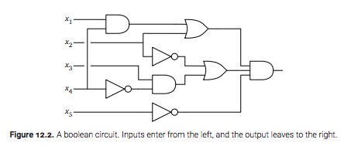
Should you play the game?
No matter what you answer, the salesman can just produce a circuit that is inconsistent with your answer (unless you have tried all 2^{n} settings)
What if the salesman shows you the circuit?

Slide 4
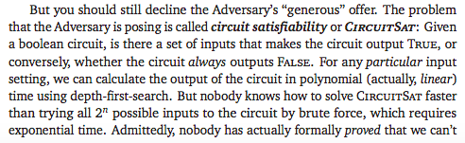
Should you play the game?
Nobody has shown whether this is impossible, either!

Slide 5
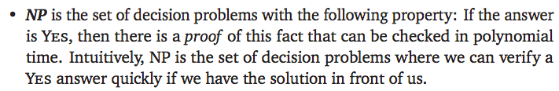

P vs NP

Slide 6
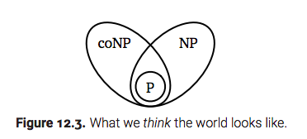
P vs NP
It is easy to see the CIRCUIT-SAT is in NP : a satisfying assignment is a proof
We don’t know whether CIRCUIT-SAT is in P
We don’t know whether CIRCUIT-SAT is in co-NP either: There is no proof that tells us that the circuit is not satisfiable.

Slide 7
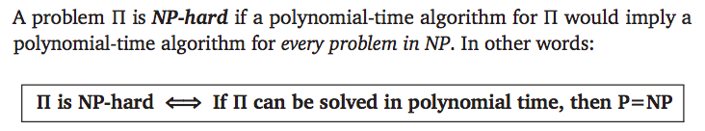
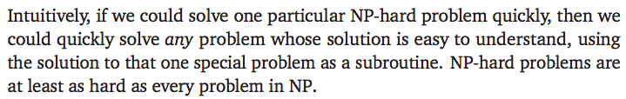
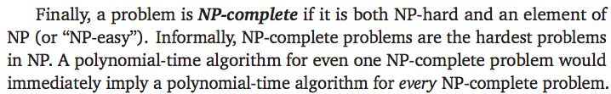
NP hardness and NP-completeness

Slide 8
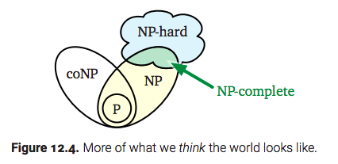
NP hardness and NP-completeness
We will not see a proof of this theorem, but only what it implies!

Slide 9

How to prove NP-hardness
E.g., If we reduce CIRCUIT-SAT to A, then a polynomial time algorithm for A will imply a polynomial time algorithm for CIRCUIT-SAT
(which will imply a polynomial time algorithm for all of NP)
Hence shows that A is NP-hard!

Slide 10
How to prove NP-hardness
We will assume the NP-hardness of CIRCUIT-SAT, and start from there!

Slide 11
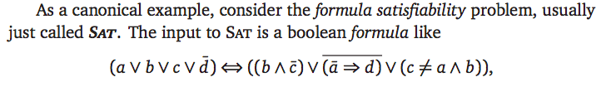
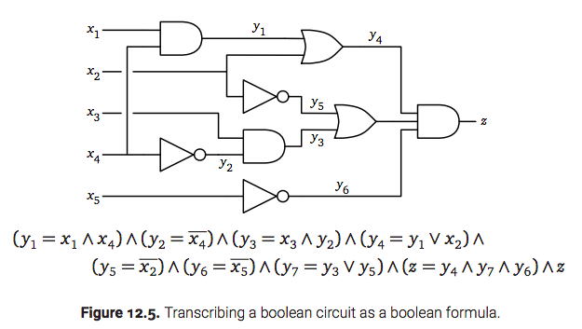
SAT

Slide 12
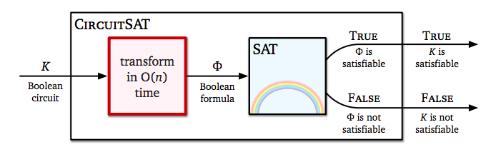
Circuit-SAT to SAT reduction

Slide 13
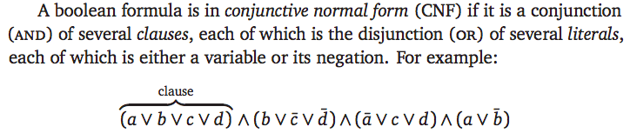
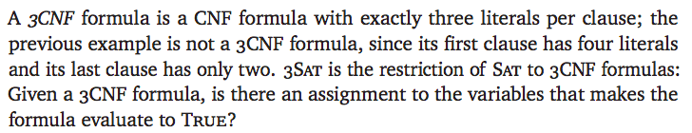
3-SAT

Slide 14
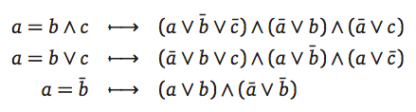

Circuit-SAT to 3-SAT
We can transform every gate into at-most-3 clauses
Changing 1-clause and 2-clause to 3-clause with auxiliary variables

Slide 15
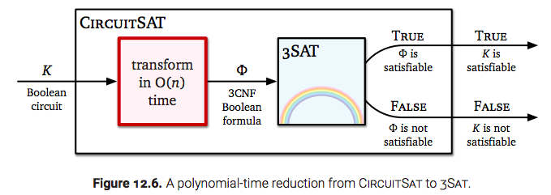
Circuit-SAT to 3-SAT

Slide 16
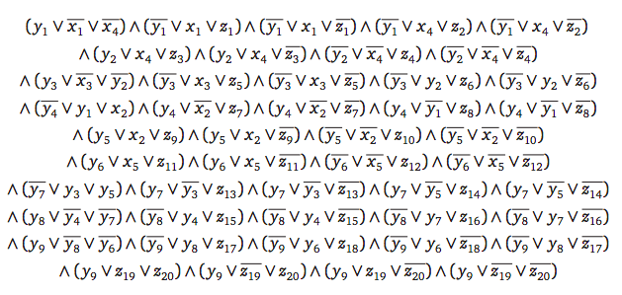
3-SAT formula for the circuit we saw..
At first glance, this formula might look a lot more complicated than the original circuit, but in fact, it’s only larger by a constant factor.

Slide 17
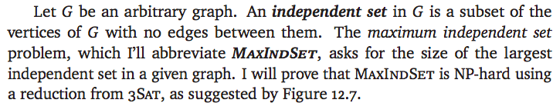
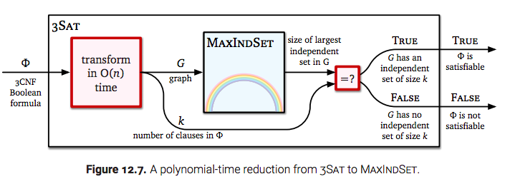
Maximum Independent Set (from 3-SAT)

Slide 18
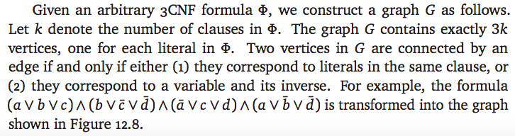
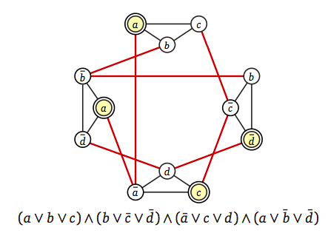
Maximum Independent Set (from 3-SAT)
The graph has an independence set of size at most k
The independence set has size k if and only if the 3CNF is satisfiable.

Slide 19
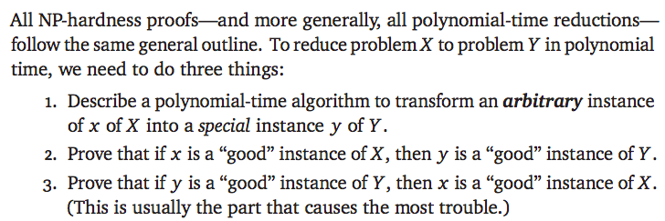
The general pattern
You have to think of all these tasks simultaneously!

Slide 20
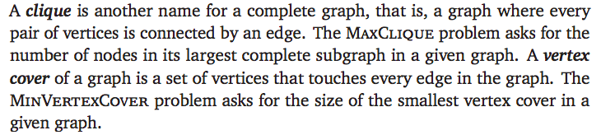
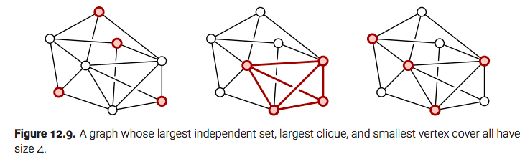
Clique and vertex cover

Slide 21
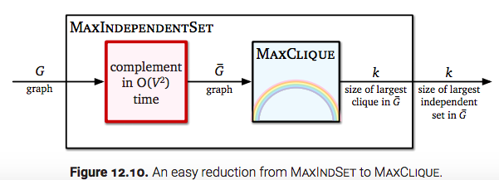
From Independent set to Clique
Easy reduction: Just consider the complement graph. If G has an independent set of size k, then G’ has a clique of size k.

Slide 22
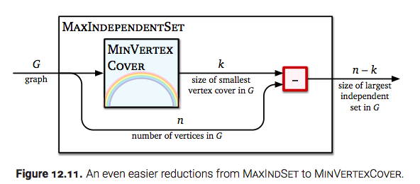
From Independent set to Vertex Cover
If V₁$⊆$ V is an independent set in G = (V, E), then V \ V₁ is a vertex cover

Slide 23
From Independent set to Vertex Cover
If V₁$⊆$ V is an independent set in G = (V, E), then V \ V₁ is a vertex cover

Slide 24

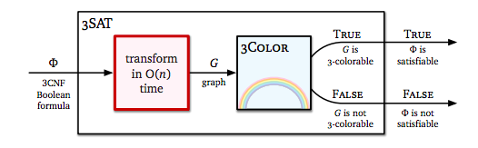
Graph 3-coloring
Graph coloring problem asks for a coloring of a graph with minimum number of colors
3-coloring problem: Does there exist a proper 3-coloring?

Slide 25
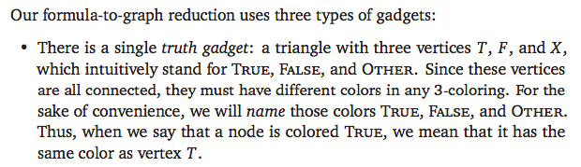

3-SAT to 3-coloring reduction

Slide 26
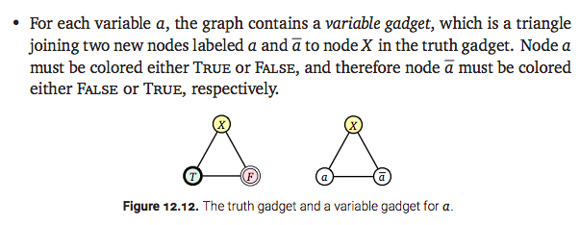
3-SAT to 3-coloring reduction

Slide 27
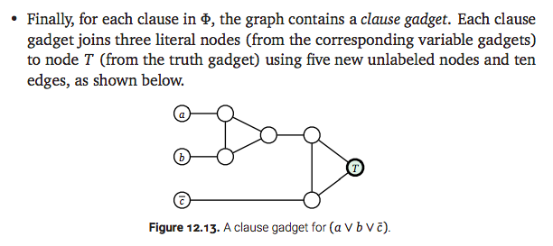
3-SAT to 3-coloring reduction

Slide 28
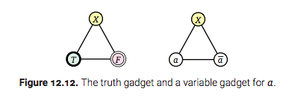
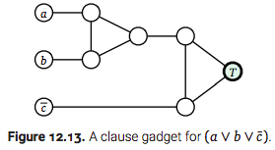
Altogether..

Slide 29
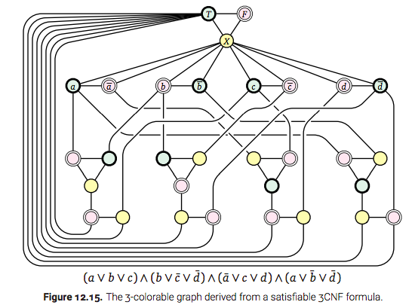
The complete reduction

Slide 30

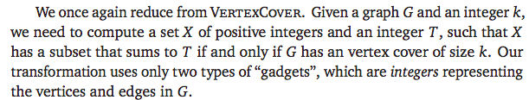
Subset sum

Slide 31
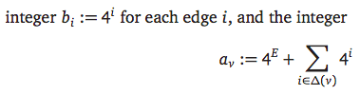
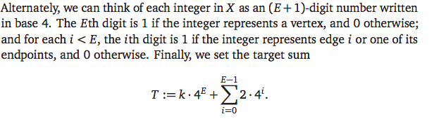
Reduction

Slide 32

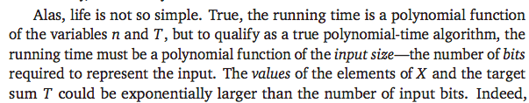
Remark!

